Slide 1



SDA-LUND
GROUP 2 – CENTRAL SYSTEM ADMINISTRATOR
PROJECT DOCUMENTATION
TITLE: CALL HANDLING SYSTEM

Slide 2
Business Requirements from Customer:
Requirements document of the project was received on 2nd March 2020 from the customer/client CIO. After initial reading to capture business requirements and chalking out the understanding, a meeting with CIO took place to clarify a few points. Based on the clarifications received another round of drafting and enhancing business requirements collection was done.
After a few iterations and spending a day without reaching a conclusive satisfactory set of business requirements, it was realized that a meeting should take place between all the different groups managing different solution areas of the project, and collaborate on requirements.
Groups Collaboration:
A proposal to call such a meeting was sent to all the groups, which was warmly welcomed and a meeting happened on day 2. After several debate sessions on how each group is looking at the business requirements, it was agreed and one person from one of the group was nominated to gather this understandings of each group in order to chalk out one single solution diagram of the whole solution. The first round gave a very good clarity, and by 4th iteration of this exercise a crisp solution diagram was in place, which was then shared with customer CIO who agreed to it. From this solution diagram, each group picked their take away of business requirements by end of 2nd day.
Translating Business Requirements:
Our team used these business requirements for translating them into functional and non-functional requirements of the solution and a flow chart with activity diagram was chalked out for the administration and security module of the solution.
Initially 2 teams in our group started working on a flow diagram based on their understanding, this was later reconciled and a final flow diagram was chalked out using both of it. A lot of ambiguity was clarified in numerous meetings with the customer CIO and a clear flow was finalized.

Slide 3
Project Documentation Stage:
An initial outlook of the administration module looked very simple, managing access to various options on the menu items. However, the greater part that was not very obvious in any project documents initially was to manage the database and provide security at database levels.
Adopting Agile:
Our initial working to produce system documentations like list of requirement, traceability matrix, flowchart, activity diagram, use case diagram, test cases and sequence diagram was very slow as each member of the team was involved in producing these documents one by one, however later we distributed the work and decided to sync and collaborate twice a day. This worked well for us and gave us an edge on delivering expected results much faster. This also enabled us to sync our working with the customer for his acceptance on each completed step. Hence making our approach truly agile.
Areas of Improvement:
Here I would like to highlight some areas where things could have been done better:
Besides the obvious delay of one full day working in isolations and confusions, and realizing that the collaboration of all teams had to be done as a first step itself.
We feel that this collaborative meetings with other groups should have been done after each phase of completion during the documentation. This we feel could have refined the system quality further to what we have now. However this couldn’t be accomplished due to the shortage of time and the various teams working with different speeds.
Similarly, in our group, our initial approach was that all of us were working together on each step, which was later changed into distribution of work and collaborations twice a day. This step should have been adopted from the first minute to avoid initial delays and had given us more time.

Slide 4
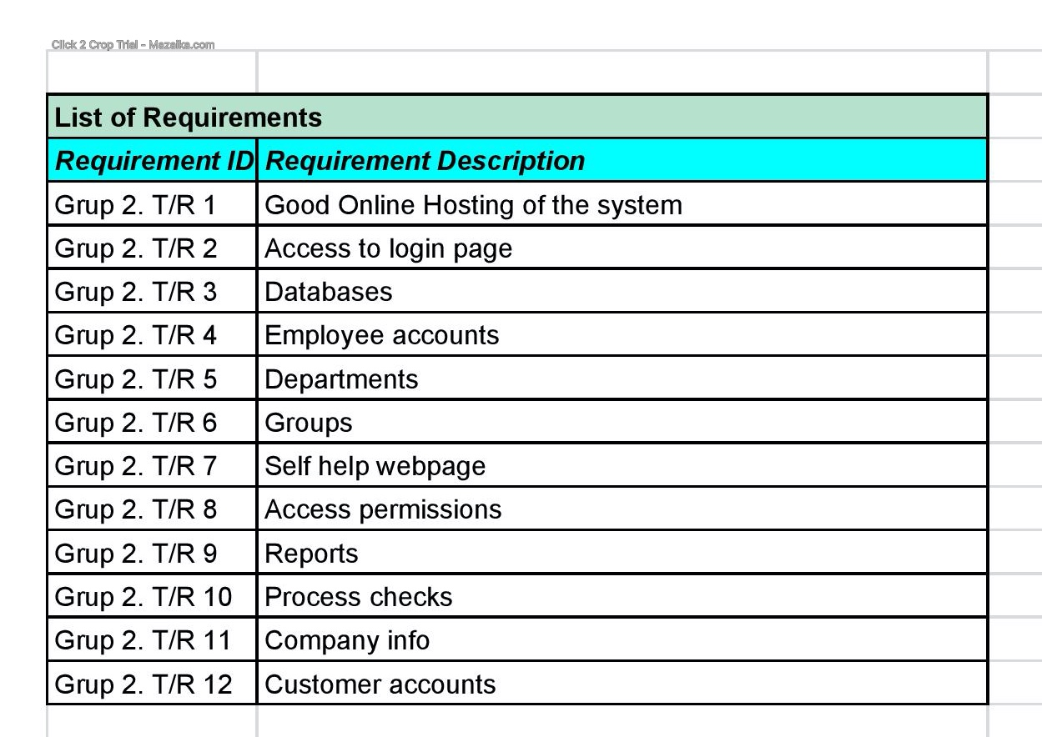

Slide 5
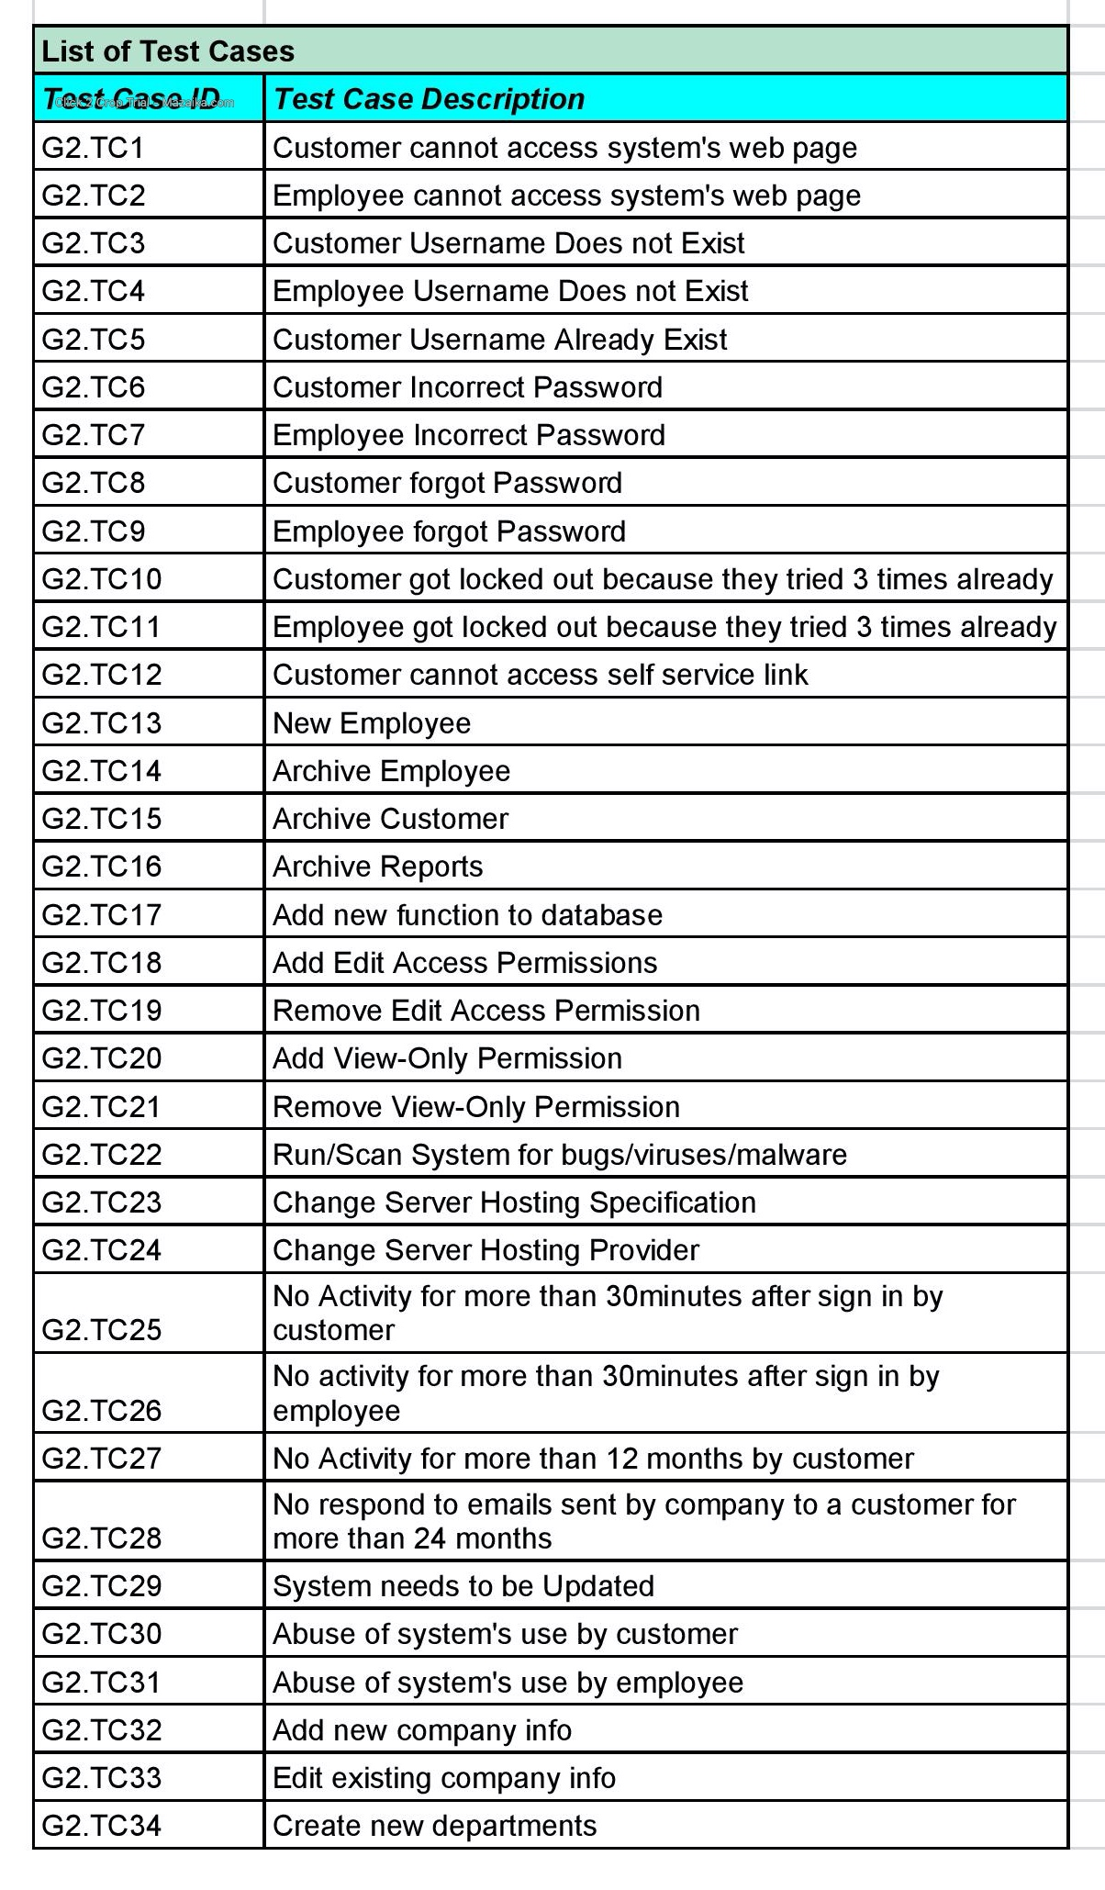
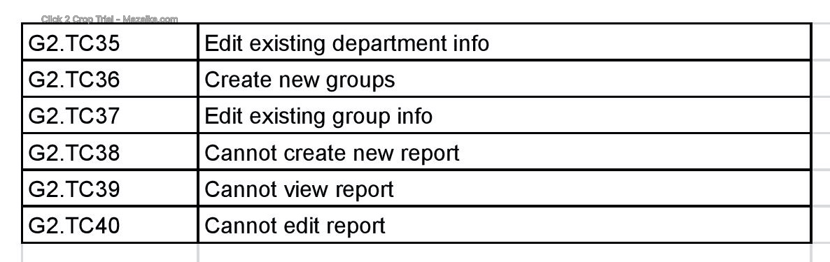
List of Test Cases

Slide 6
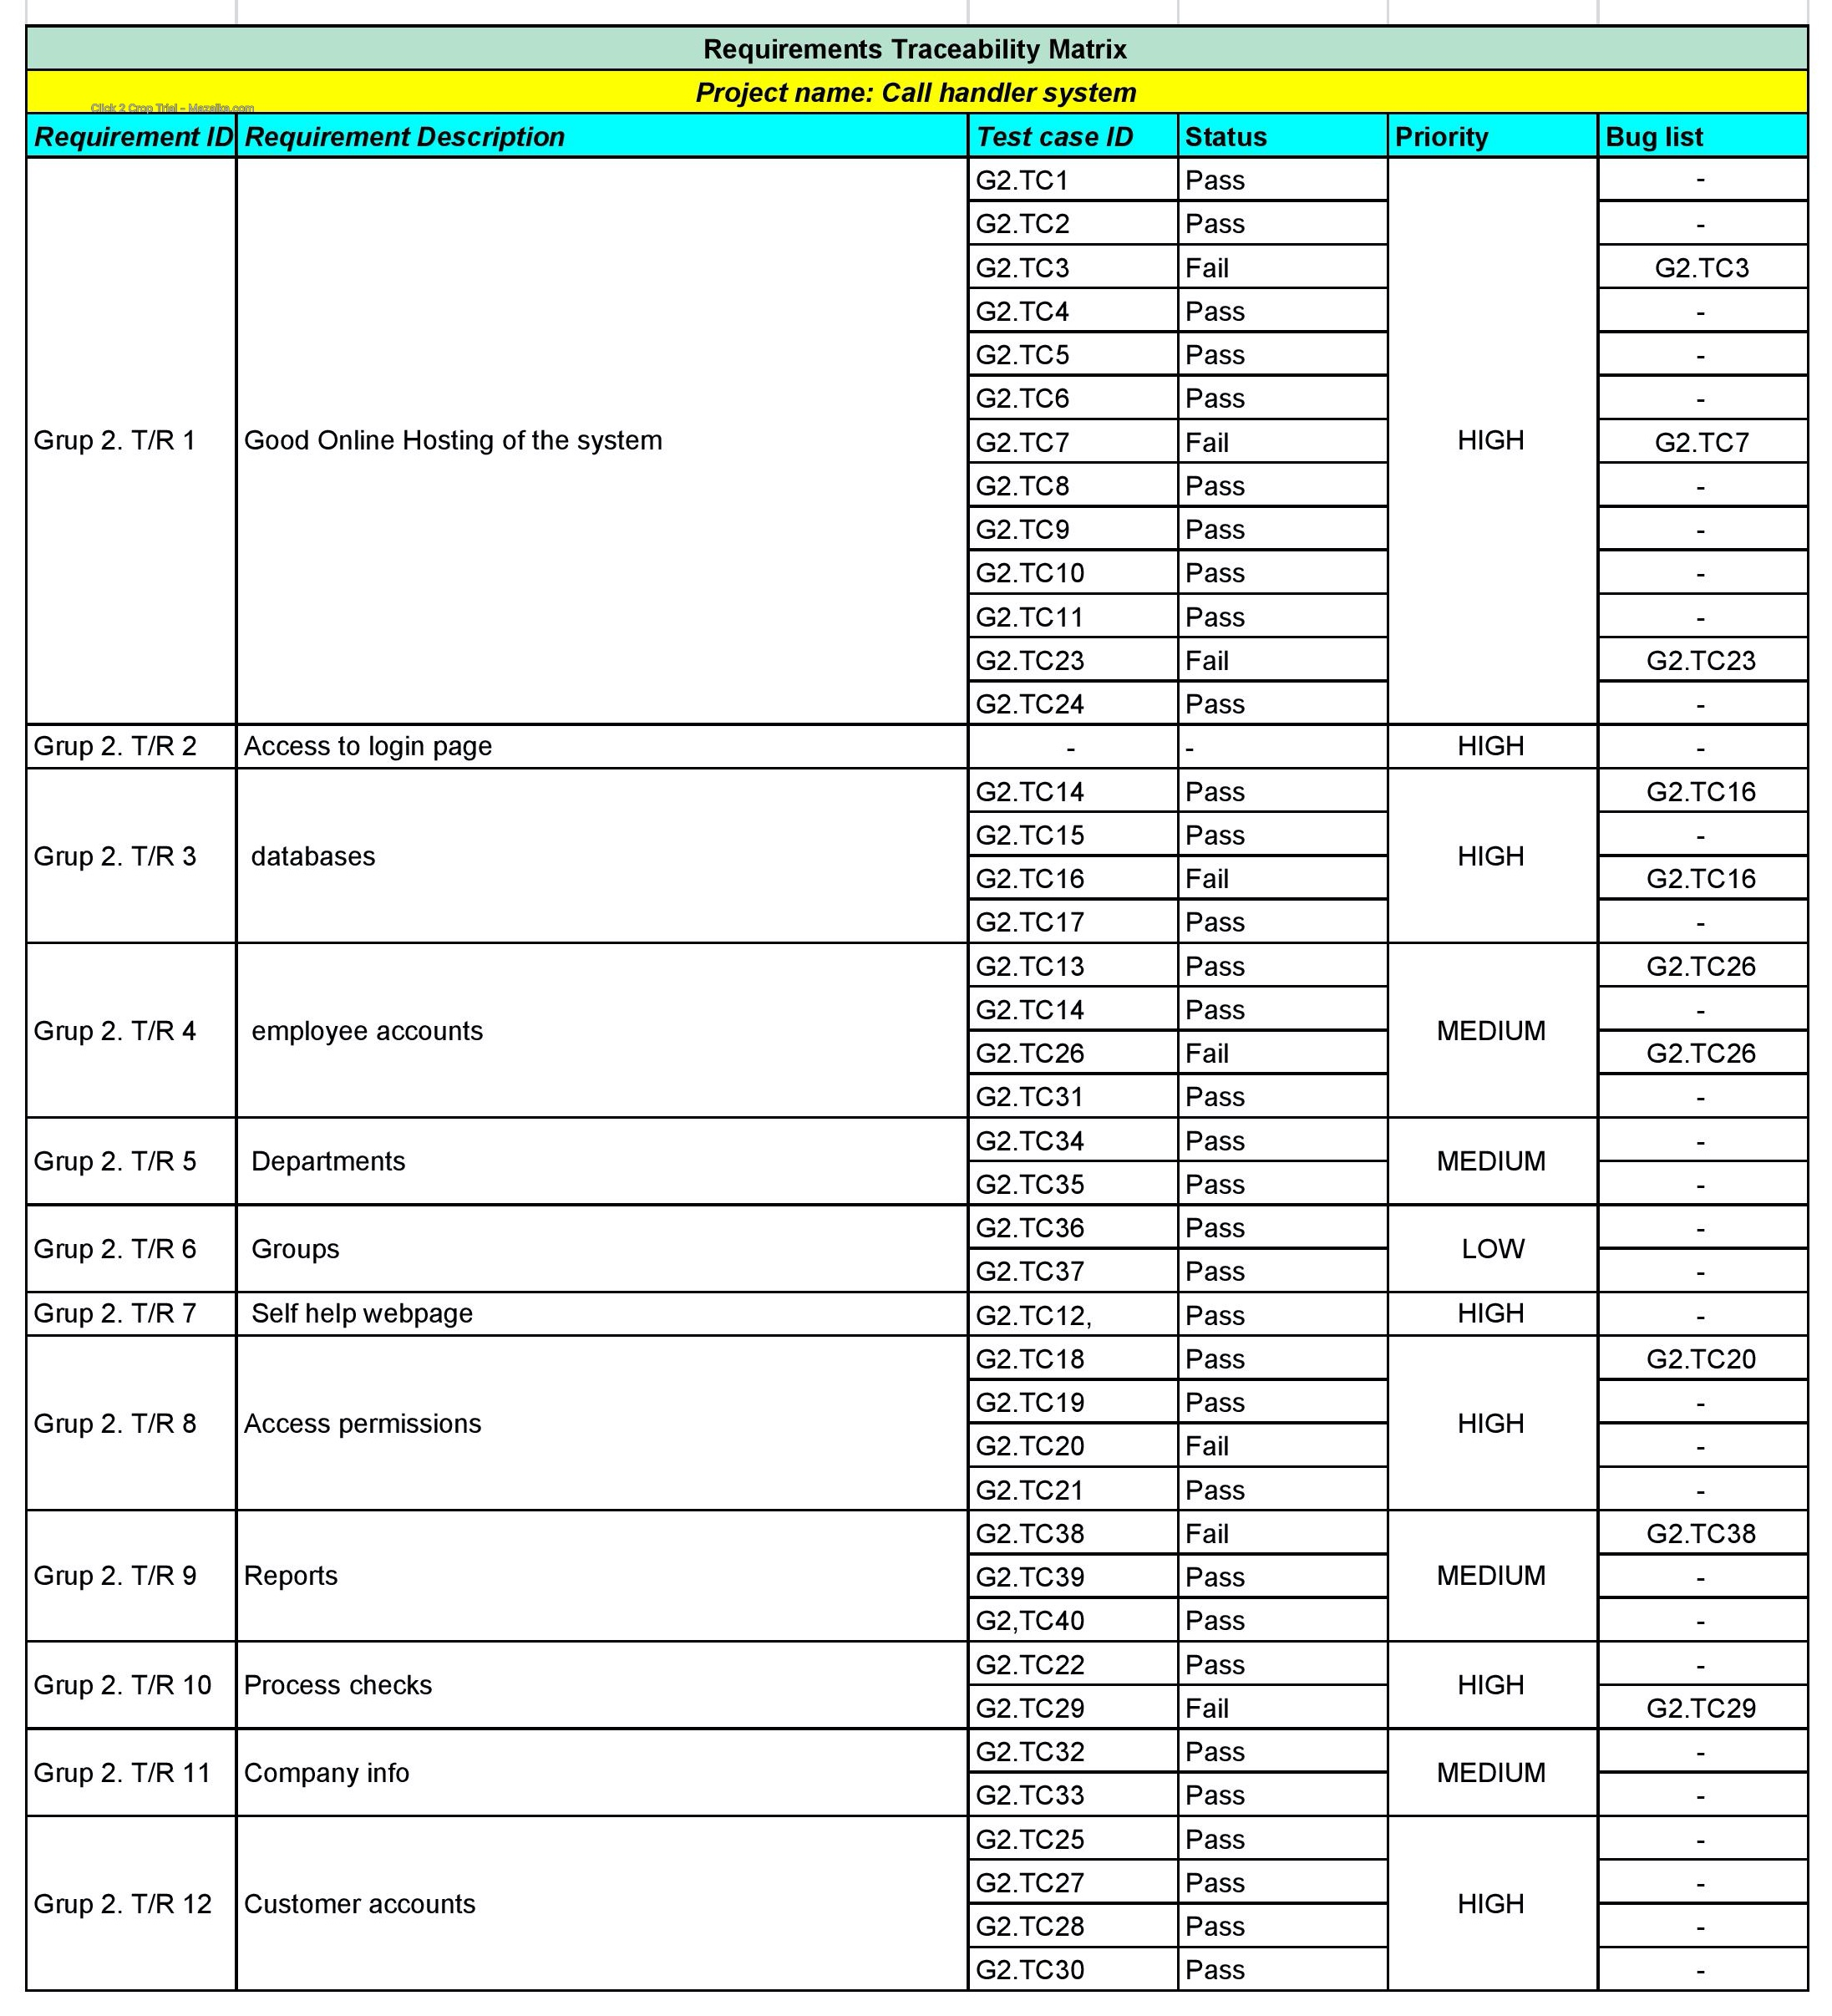
RTM

Slide 7
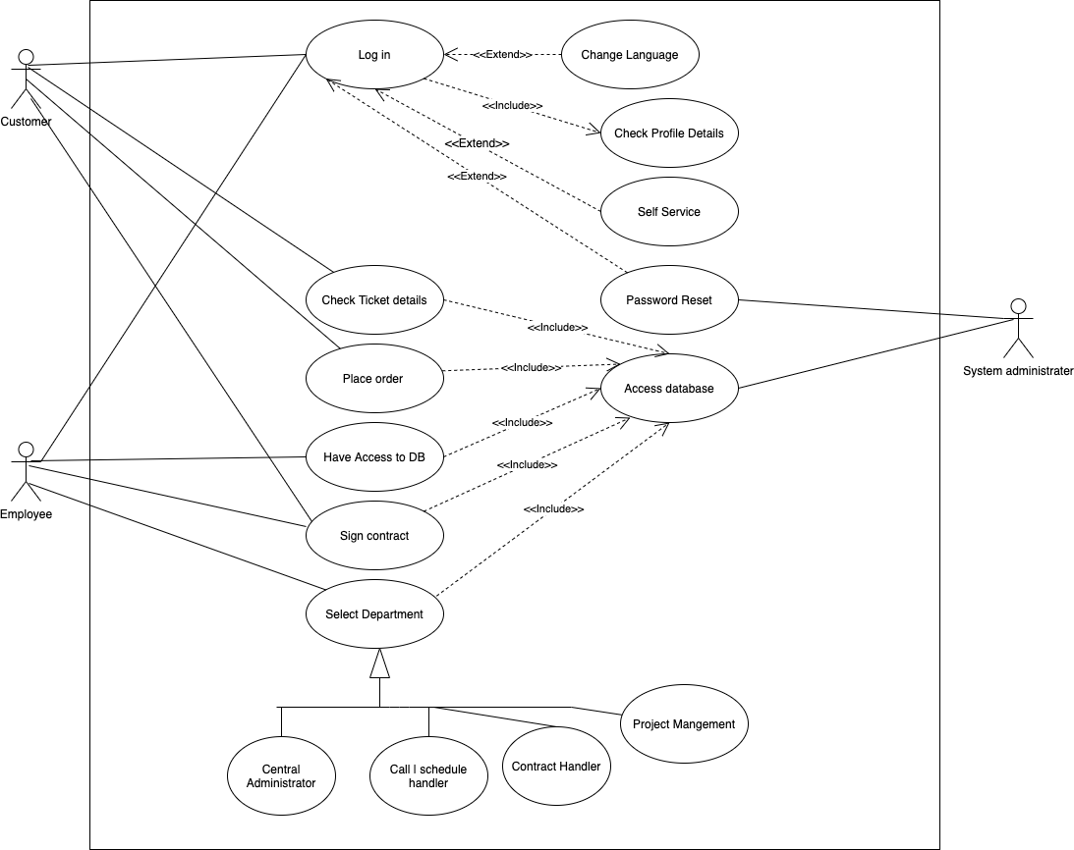
Use Case Diagram

Slide 8
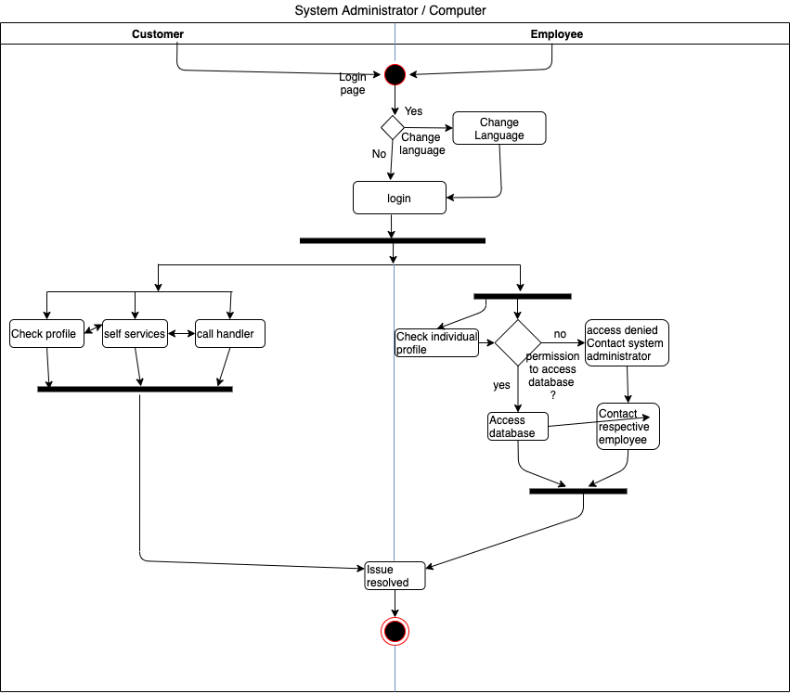
Activity Diagram

Slide 9
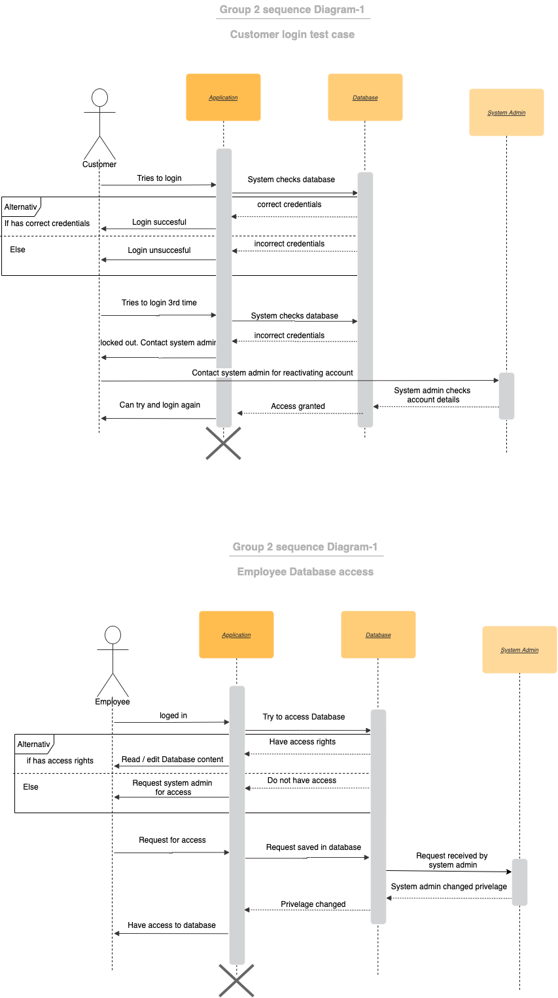
Sequence Diagram 1.
Test Case: Customer Login
Sequence Diagram 2.
Test Case: Employee Access Rights to Databases

Slide 10
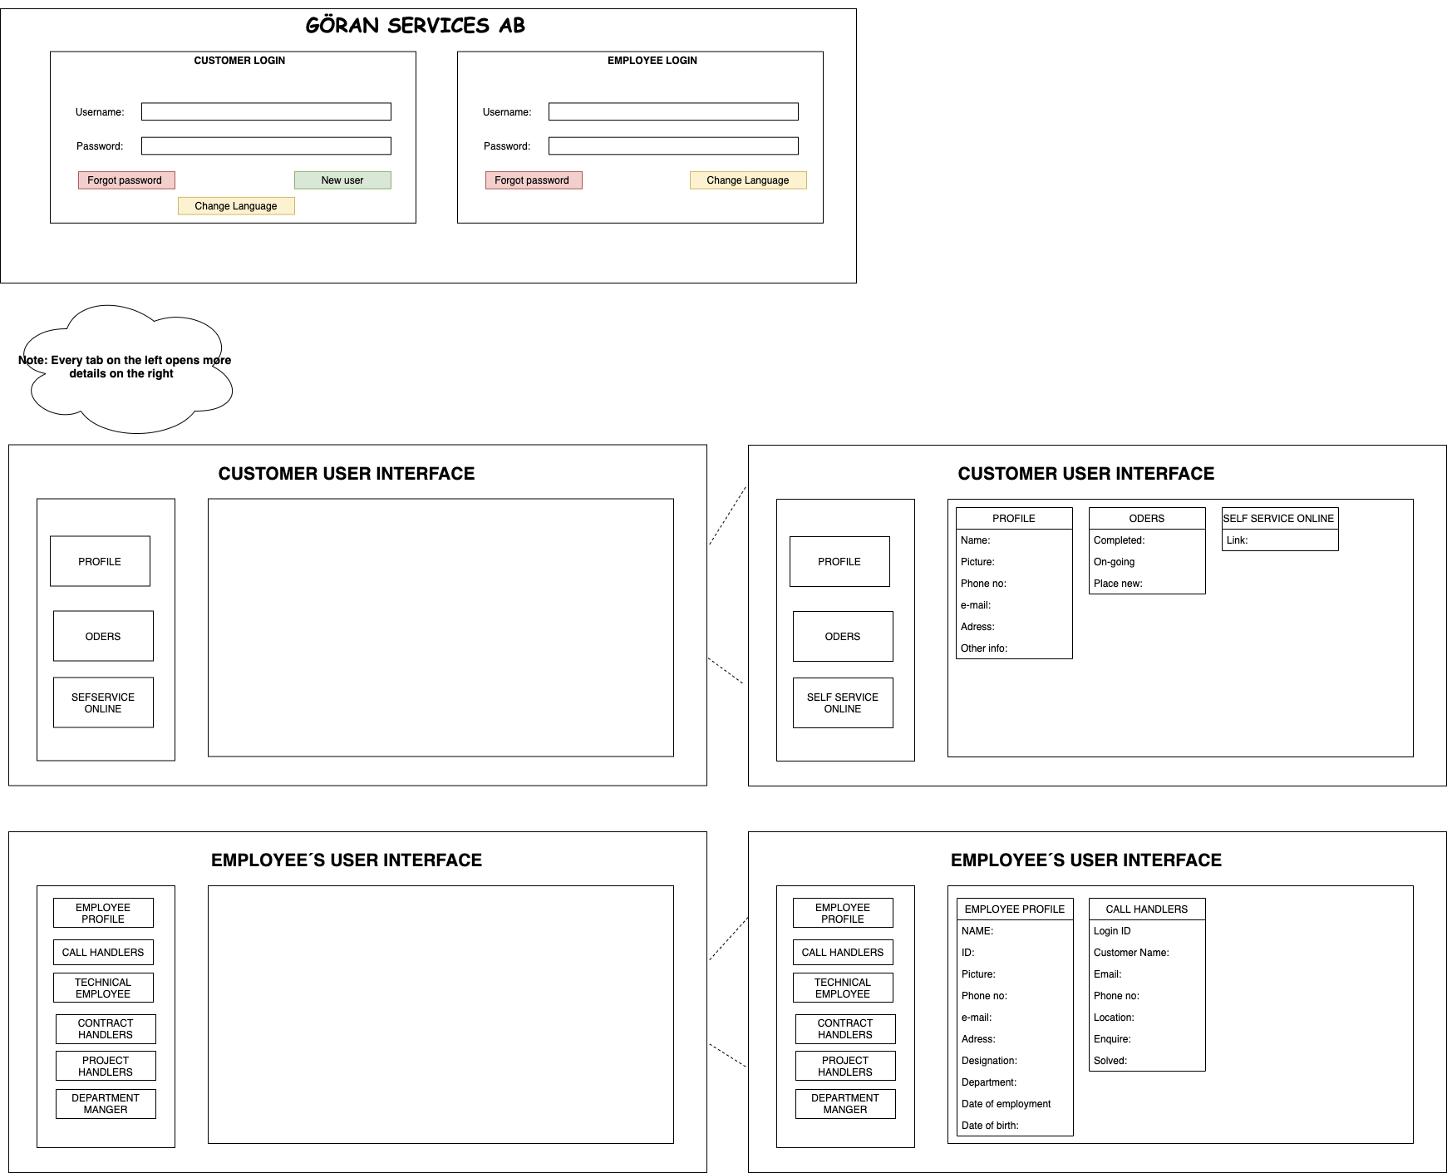
UI/UX Prototype Design

Slide 11
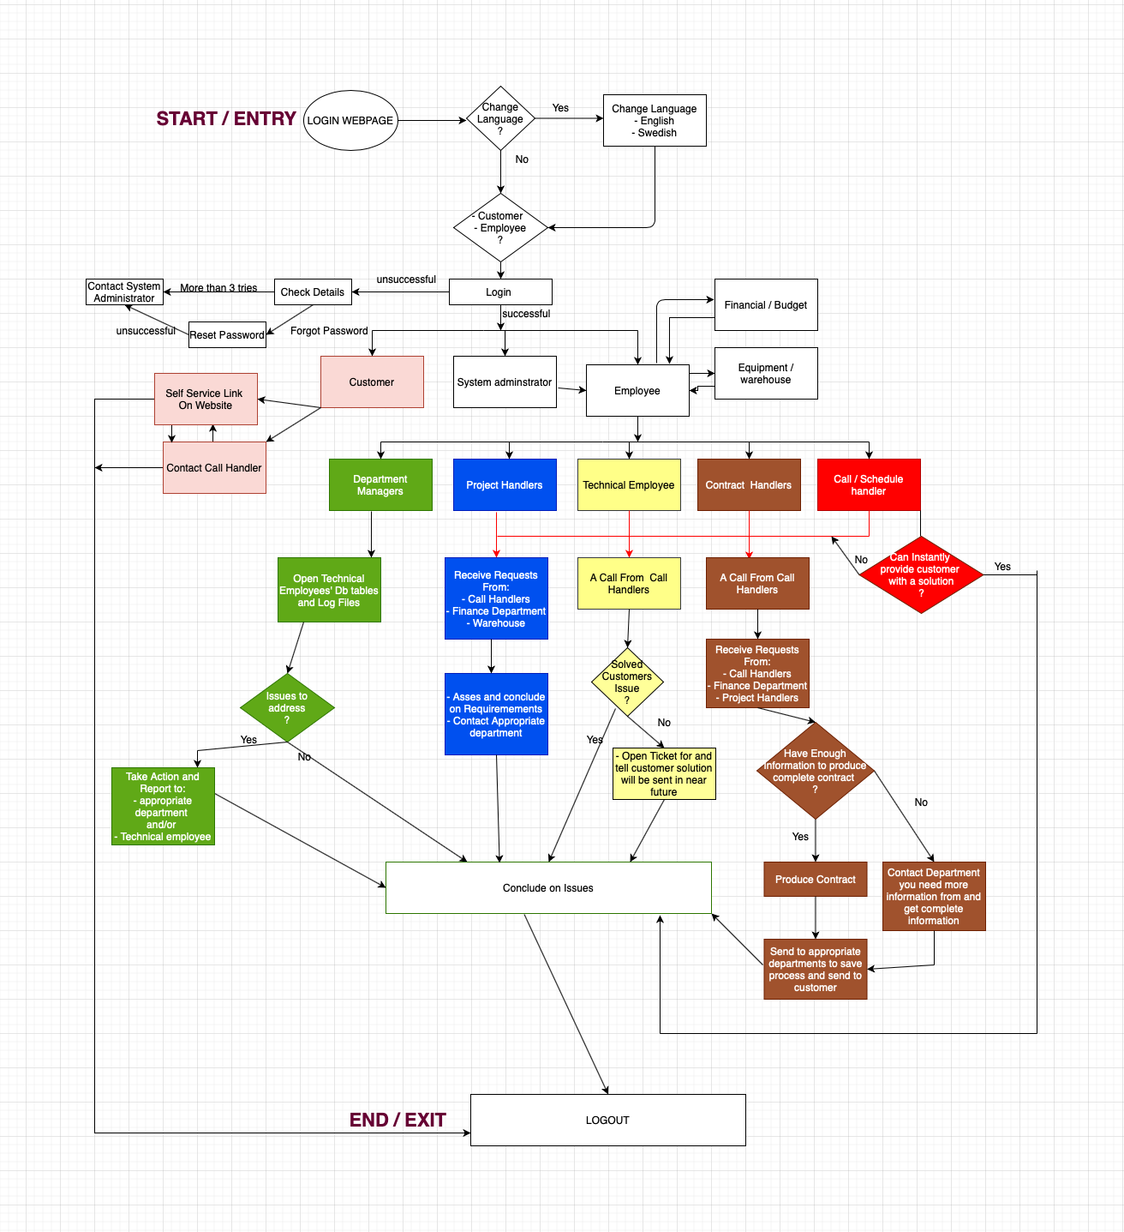
Central Administration Model
Customer
Department Managers
Project Management Handler Model
Technical Employee
Customer/Contract Handler Model
Call/Schedule Handler Model
Flow Chart of the whole call handling system project.

Slide 12
CONCLUSION
From the previous slide we can see how well we function together with the other modules especially as we are the System and System admins which provide the other modules details on how they interact in the system.
Areas of Improvement:
Here I would like to highlight some areas where things could have been done better:
We could have collaborated more especially at the beginning of the project to better define what each module’s roles and tasks are.
If we had more time we would have added more system functions to further ease the use of the system.
In addition to the above documentation we could add a detailed user manual for the employees which will further explain how a particular employee in a department will use all functions of the system.
Also we started working waterfall at the beginning but later adopted the agile model for more efficient and collaborative.

Slide 13

QUESTIONS ?

